Slide 1
Semantic Annotation APIs
Find more information about the Security Patches in Capgemini Tools / Security Patches / Info
Hannover, 14 June 2019, Gul Jabeen

Slide 2
Agenda
SEC1
Objectives
Summary
Next Steps
To create an agenda slide for each item, click on „Updat Agenda“ in the „Capgemini Tools“

Slide 3
APIs related to Semantic annotations
SEC1
APIs
NLTK
Stanford CoreNLP 3.9.2
Spacy(spaCy is not a platform or “an API”. )
Open nlp
Open Calais

Slide 4
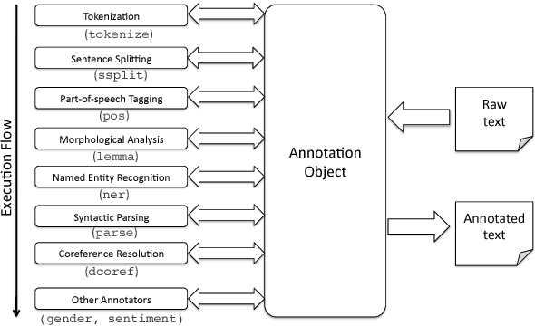
NLTK
SEC1
Stanford CoreNLP 3.9.2
Semantic Annotation APIs
Open nlp
SpaCy
Open Calais
Figure1: Architecture of stanford CoreNLP

Slide 5
SEC1
NLTK (Natural Language Toolkit)
spaCy
OpenNLP
CoreNLP
OpenCalais
NLTK is a leading platform for building Python.
It provides easy-to-use interfaces to over 50 corpora and lexical resources.
Such as WordNet, along with a suite of text processing libraries for classification, tokenization, stemming, tagging, parsing, and semantic reasoning, wrappers for industrial-strength NLP libraries
NLTK is a free, open source, community-driven project.
spaCy is a free, open-source library for advanced Natural Language Processing (NLP) in Python.
spaCy is not a platform or “an API
spaCy is designed specifically to “understand” large volumes of text.
It can be used to build information extraction or natural language understanding systems, or to pre-process text for deep learning
Apache OpenNLP is an open source Natural Language Processing Java library.
OpenNLP supports the most common NLP tasks.
Such as tokenization, sentence segmentation, part-of-speech tagging, named entity extraction, chunking, parsing, language detection and coreference resolution.
Stanford CoreNLP provides a set of human language technology tools
It can give the base forms of words, their parts of speech, whether they are names of companies, people, etc
normalize dates, times, and numeric quantities
Mark up the structure of sentences in terms of phrases and syntactic dependencies
indicate which noun phrases refer to the same entities
Indicate sentiment
Extract particular or open-class relations between entity mentions
Get the quotes people said, etc.
Open Calais uses NLP and machine learning algorithms where user feed unstructured data into extraction engine like blogs, news articles
To examine the users text and locate entities, relationships, facts, events and topics.
Open Calais offers entities, topic codes,events, relations and social tags.
Relevance and confidence
Free service

Slide 6
APIs available for Java and Python
SEC1
Libaries for NLP tasks in Java & Python
Python | Java
NLTK | Freeling
TextBlob | OpenNLP
Gensim | LingPipe
Pattern | Stanford CoreNLP
Spacy | CogComp NLP
Orange
Pineapple

Slide 7
Feature comparsions of APIs
SEC1
Here’s a quick comparison of the non-functionalities offered by spaCy, openNLP, Open Calais, NLTK and CoreNLP.
Sr.no | Criteria | Spacy | NTLK | CoreNLP | OpenNLP
1. | Programming language | Python | Python | Java/Python | Java
2. | Speed | Over 400 times faster than NLTK | Slow speed than Spacy | CoreNLP is very slow than spaCy because it uses large model files of parameters for various components and they take lots of time to load. | Slower than coreNLP
3. | Language support | The main dra wback of spaCy — it only supports English and German | Support multiple languages | Stanford has a handful more, but not all features are supported for all languages | Support multiple languages
4. | Acurracy | State-of-the-art accuracy. | Low accuracy | latest model with state-of-the-art accuracy. means gives best accuracy | Corenlp has better accuracy than openNLP
5. | API performance | Powerful and concise api | Model return list of strings | Powerful API | Not powerful API than Spacy and CoreNLP

Slide 8



Feature comparsions of APIs
SEC1
Here’s a quick comparison of the functionalities offered by spaCy, openNLP, Open Calais, NLTK and CoreNLP.
Sr.no | Criteria | Spacy | NTLK | CoreNLP | OpenNLP | Open calais
1. | Programming language | Python | Python | Java/Python | Java | Java/Python
2. | Neural network models
3. | Integrated word vectors
4. | Multi-language support
5. | Tokenization
6. | Part-of-speech tagging
7. | Sentence segmentation
8. | Dependency parsing
9. | Entity recognition
10. | Entity linking
11. | Coreference resolution

Slide 9
Feature comparsions of APIs
SEC1
Here’s a quick comparison of the functionalities offered by spaCy, openNLP, Open Calais, NLTK and CoreNLP.
Sr.no | Criteria | spaCy | NTLK | CoreNLP | OpenNLP
1. | Programming language/ Client | spaCy is a proper python lib | Python Library | Stanford uses Java but there are third-party wrappers for other languages. | Java Library
2. | Features | For English, spaCy and Core NLP offer dependency parsing and POS tagging with effectively the same Universal Dependency tag set | NLTK is great for pre-processing and tokenizing text. you can't parse syntactic dependencies out of the box with NLTK | spaCy and Stanford also offer sentence segmentation, named-entity recognition. | OpenNLP can support you with the following tasks: Sentence Detection, Tokenization, Chunking, Named Entity Recognition, Pos Tagging, Parsing, Stemming, Language Model, Lemmatization, Document classification
3. | Integrated word vectors | Integrated word vectors: Most word vector libraries output an easy-to-read text-based format, where each line consists of the word followed by its vector. For everyday use, we want to convert the vectors model into a binary format that loads faster and takes up less space on disk. | No word vector support that’s why it has low speed. | CoreNLP has word vector support | OpenNLP has word vector support
3. | Tokenization before doing any extraction | Tokenizer maintain a simple alignment between the tokens and the original string, and it ensure that no information is lost during processing. | Token don’t align to original string and data lost during processing. | Tokenization is required before doing any extraction. | Tokenization is required before doing any extraction.
4. | Part-of-speech tagging | POS-tagging spaCy performs better, but in sentence tokenization, NLTK outperforms spaCy. | NLTK performs really slow in POS tags compared to other libraries. | Stanford CoreNLP is much more efficient than OpenNLP in POS tagging | OpenNLP runs faster than Stanford CoreNLP in NER tagging.
5. | In terms of named-entity recognition (NER) | In NER spaCy performs better than NLTK, it gives state of the art results. | NLTK works well on tokenization but it has quite slow performance in NER and POS compared to spaCy and other APIs. | Stanford CoreNLP works better on general-purpose text | OpenNLP might be a better choice when one wants to extract information from text by using their own models trained on a corpus.
6. | Dependency parsing | spaCy performs dependency parsing. | NLTK doesnt provide dependency parsing. | CoreNLP also perform dependency parsing which gives better results than spaCy but its quite slower than spaCy. | CoreNLP has a quite a few dependencies which are pulled into your project, where OpenNLP has zero dependencies
7. | Entity linking | spaCy doesnt provide entity linking | NLTK doesnt provide entity linking. | coreNLP doesnt provide entity linking | openNLP provides entity linking which is the task of extracting entities (i.e. NER) and linking the entities to the entities' entry in the knowledge base.
8. | Coreference resolution | spaCy doesnt provide coreference resolution | NLTK doesnt provide coreference resolution. | CoreNLP provides coreference resolution which is the task of finding all expressions that refer to the same entity in a text. It provides accurate results but its little slow in neural network tasks. | OpenNLP provides coreference resolution but its not that accurate and fast than CoreNLP.

Slide 10
Functionality comparsion of APIs
SEC1
ACCURACY & SPEED
Package | Precison | Recall | F-score
spaCy | 0.72 | 0.65 | 0.69
CoreNLP | 0.79 | 0.73 | 0.76
NLTK | 0.51 | 0.65 | 0.58
Criteria | SpaCy | CoreNLP
Time to complete | 7 mins | 85 mins
Found entities | 7946 | 7582
Percentage out of all cities | 12.5% | 11.9%
Table 2: ACCURACY: ENTITY EXTRACTION
Package | Tokenizer | Tagging | Parsing
spaCy | 0.2ms | 1ms | 19ms
CoreNLP | 2ms | 10ms | 49ms
Table 1: Comparison Between Spacy NER & Stanford NER Using All US City Names
Table 3: SPEED: KEY FUNCTIONALITIES — TOKENIZER, TAGGING, PARSING

Slide 11
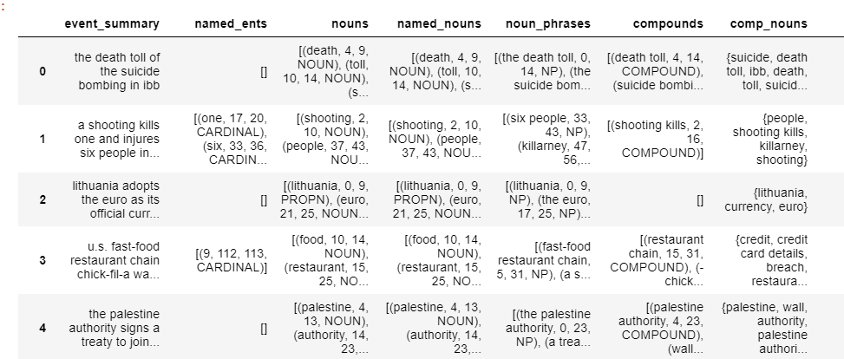
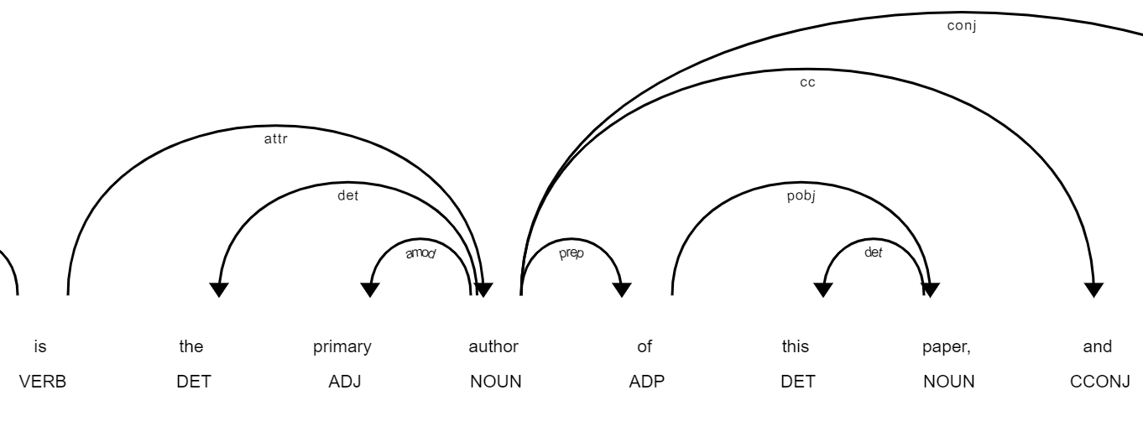
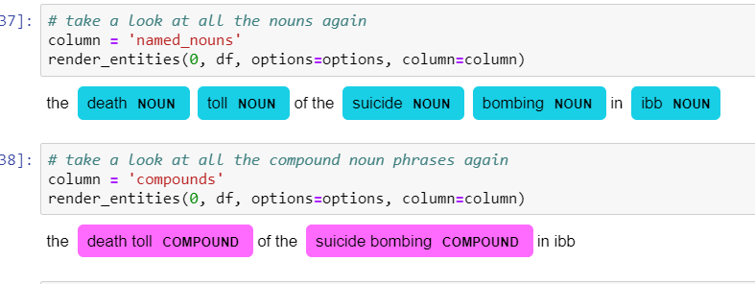
Results
SpaCy Results

Slide 12

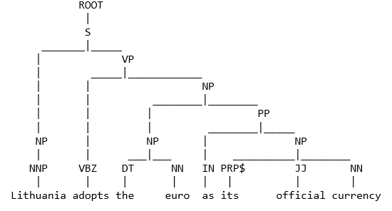
Results
CoreNLP Results
1. Take the first sentence of the dataset.
Shallow parsing/ chunking:
first identifies constituent parts of sentences (nouns, verbs, adjectives, etc.) and then links them to higher order units that have discrete grammatical meanings (noun phrases, verb phrases and propositional phrases
3. Extract all nounphrases/verbphrases/propositional phrases from each level of the parse tree and save it to the dataset.
(NP (NNP Lithuania)) (NP (NP (DT the) (NN euro)) (PP (IN as) (NP (PRP$ its) (JJ official) (NN currency)))) (NP (DT the) (NN euro)) (NP (PRP$ its) (JJ official) (NN currency))

Slide 13
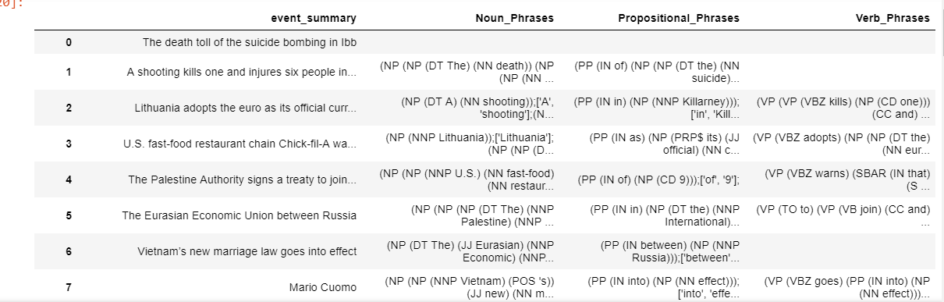
Results
CoreNLP Results
SEC1
4. Dataset view after saving phrases

Slide 14
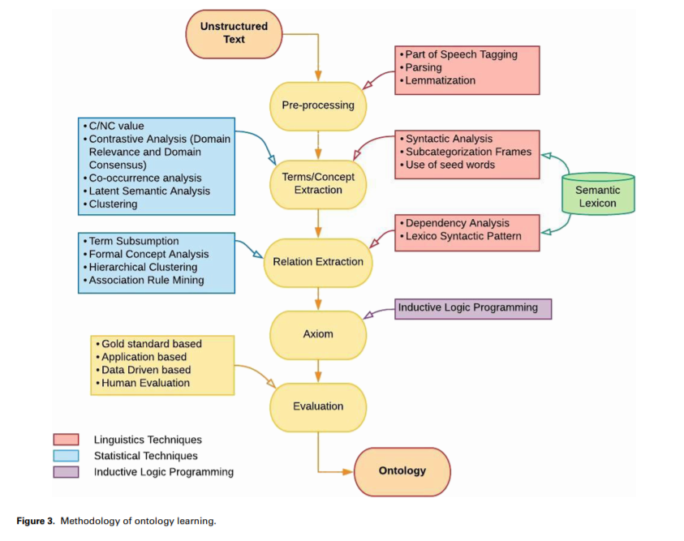
SEC1

Slide 15
SEC1

